Slide 1
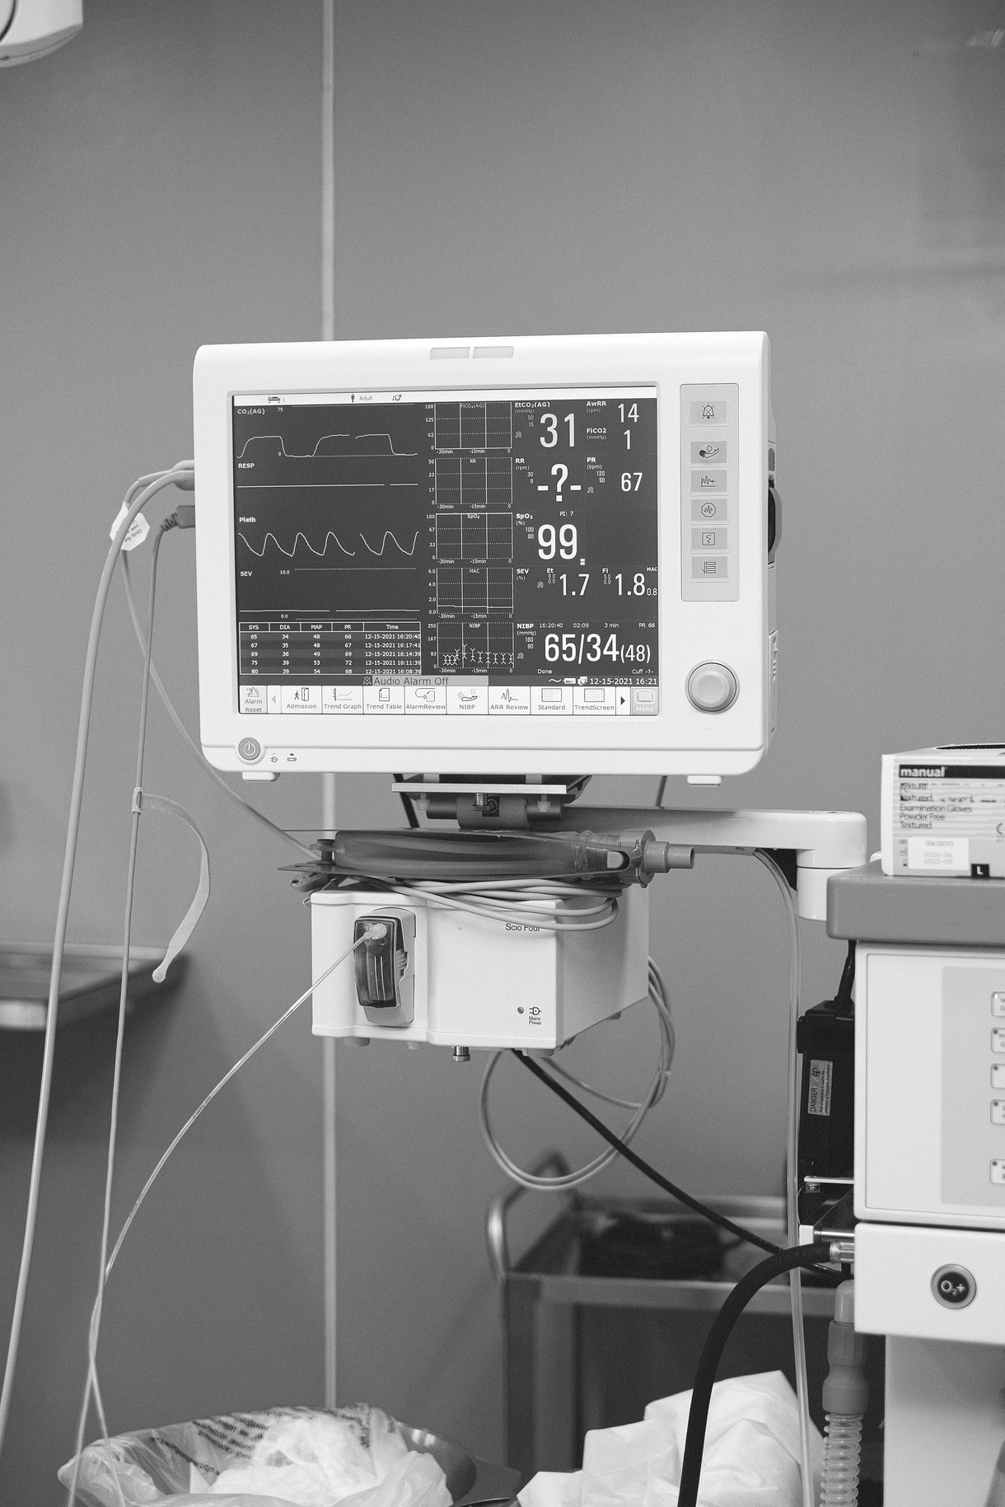
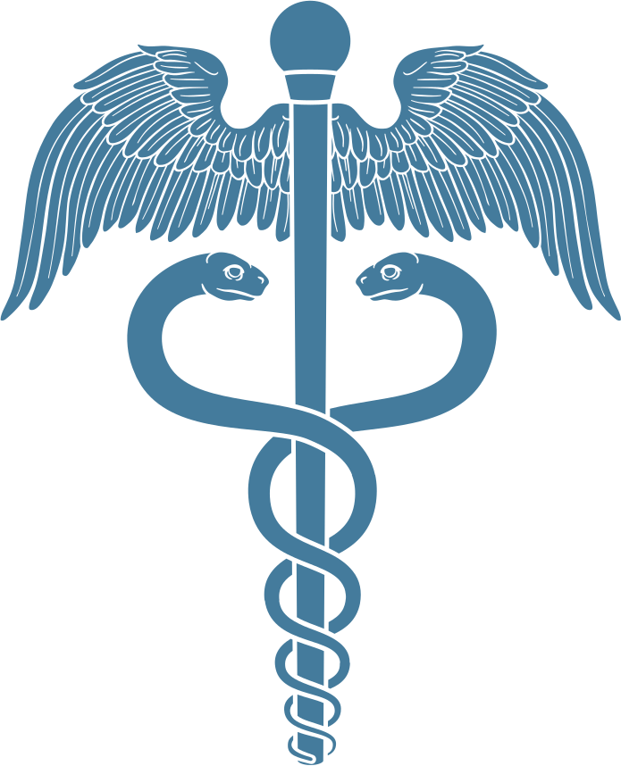

Real-Time Patient Vital Monitoring System
By: Shriansh Nauriyal & Swaroop Malina

Slide 2
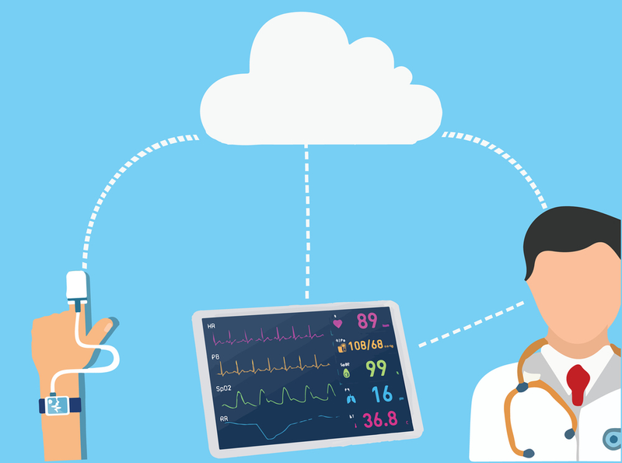
Introduction
Global internet of medical things (IoMT) market to reach $187.6 billion by 2028
More than 70 million Remote Patient Monitoring (RPM) users in US by 2025
Even today, smart wearables such as Apple Watch have started to measure important metrics such as SPo2, BP and more.
Our project is an Alert System for RPM devices
Relies on Big Data Streaming technologies such as Apache Kafka and Spark Streaming
Stores and compares Patient vital data against safe threshold values
Send alerts to doctors and medical staff via SMS or Email
Vital data and alerts data stored for future analytics
Metabase used for data visualization of the vital metrics and other analysis

Slide 3
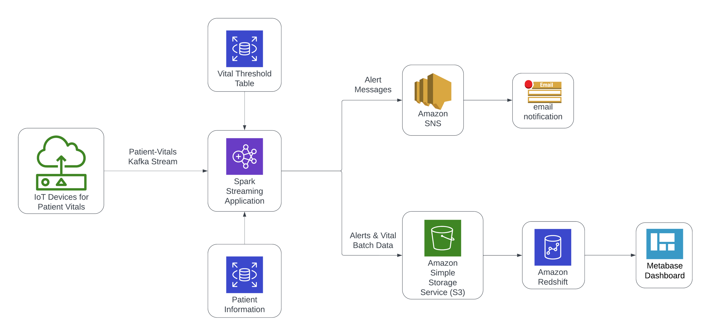
Project Flow Diagram

Slide 4
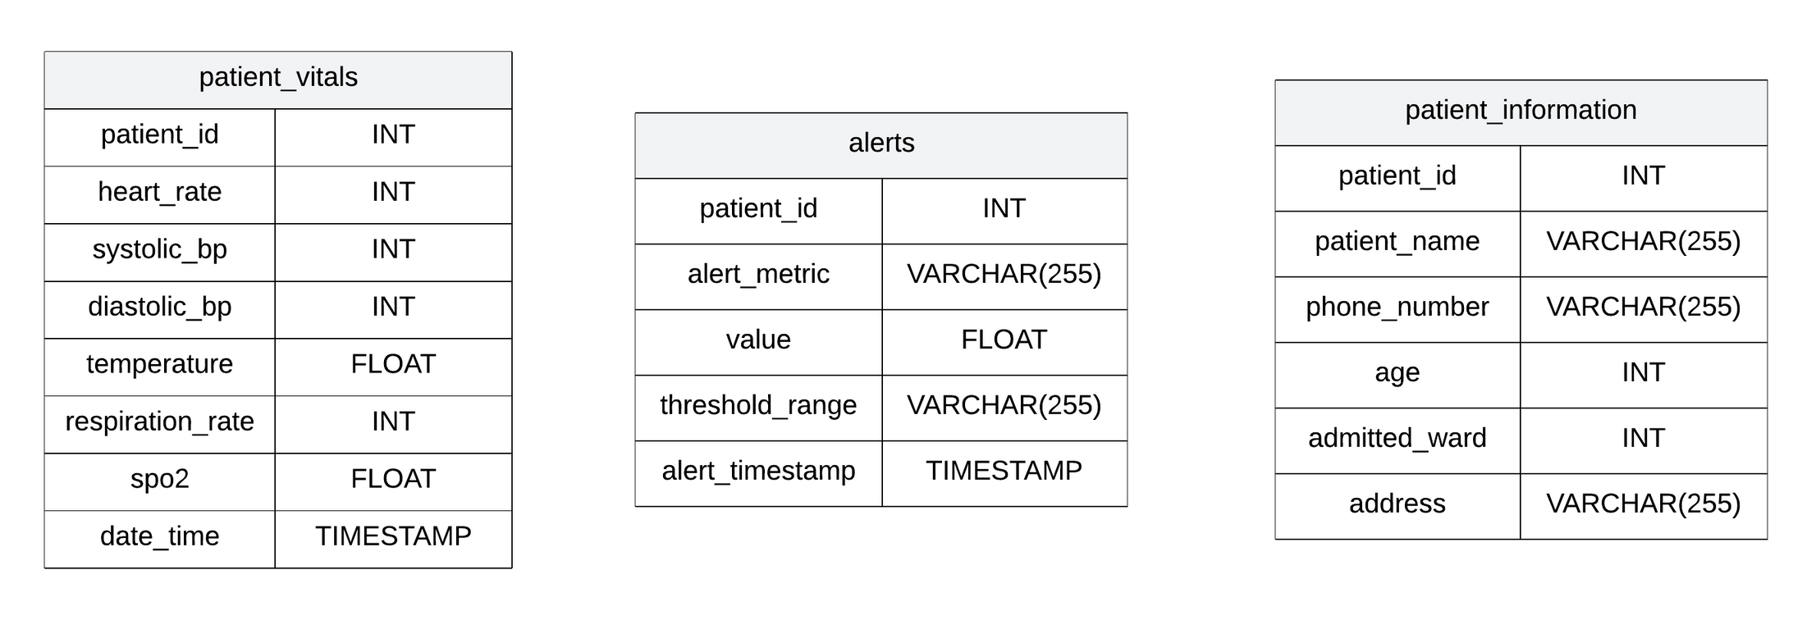
Redshift Tables

Slide 5
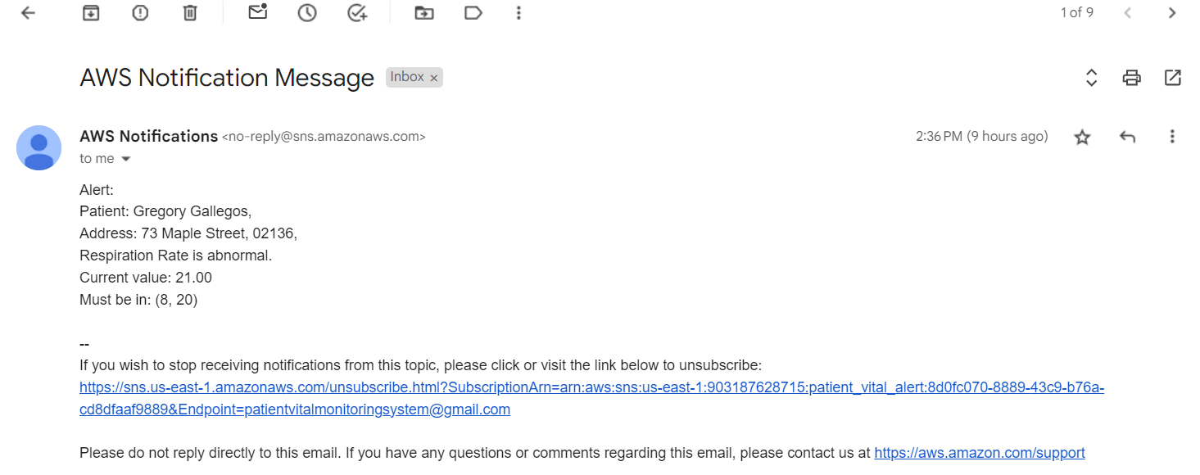
Results

Slide 6
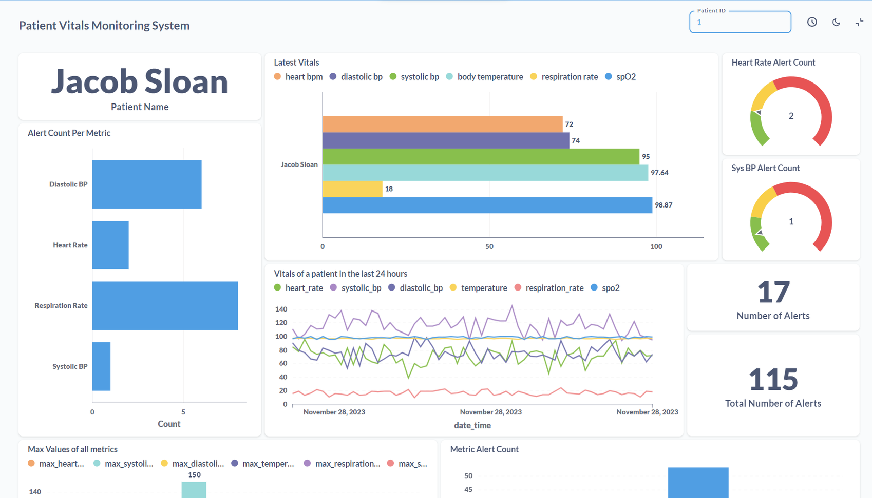
Results

